Slide 1
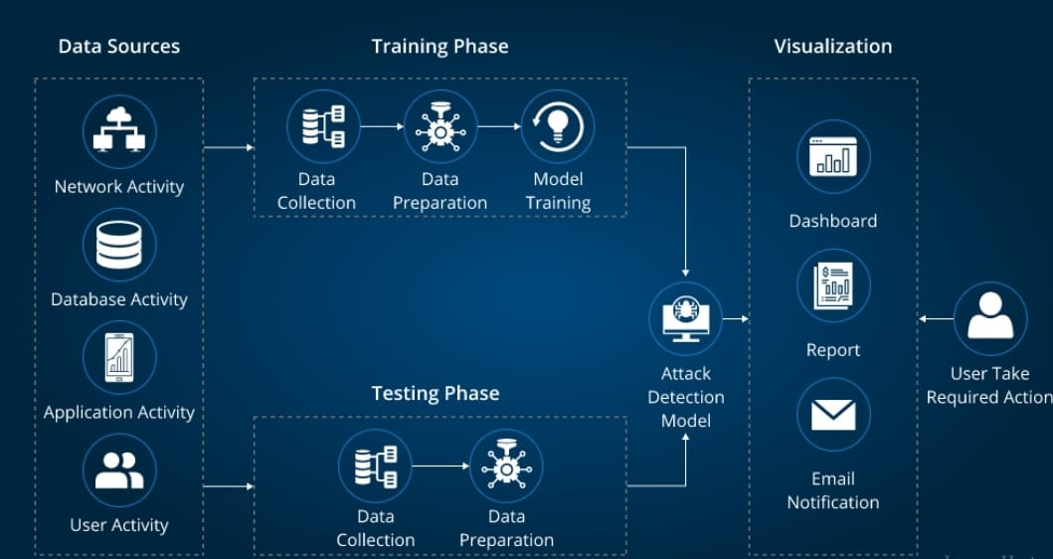
Causal Loop Diagram for Problem Solving in IT Management: Frequent data loss due to unsecured backups.

Slide 2
In the modern digital age, the frequency of data loss because of unencrypted backups is a serious worry. This issue can have significant effects for individuals and companies, leading to monetary damages, adverse publicity, and operational interruption.
Typical Reasons for Unsecured Backups:
Lack of Encryption: Without the use of encryption, sensitive data can be easily viewed and stolen by unauthorized parties.
Weak Access restrictions: Malicious actors may be able to access backup data without authorization if there are insufficient access restrictions in place, such as inadequate passwords or insufficient permissions.
Inadequate Off-Site Storage: Depending only on on-site storage raises the possibility of data loss because of physical breaches, technical malfunctions, or natural disasters.
Human error: Data loss may result from inadvertent deletions, incorrect setups, or outdated backups.
The Repercussions of Insecure Backups:
Financial Loss: Legal fees, missed income, and cleanup costs associated with data breaches can add up to substantial financial losses.
Reputational Damage: A hacking attack has the potential to undermine consumer confidence and harm a company's brand.
Operational Disruption: When a company's data is lost, it can cause downtime, lost productivity, and disgruntled customers.
Regulatory Fines: Serious penalties may be imposed for breaking data protection laws like GDPR and HIPAA.

Slide 3

To guard against data loss from unreliable backups, businesses should:
Put secure encryption and access controls in place.
Backups should be kept off-site in a safe place.
Test and upgrade backups frequently.
Inform staff members about suitable procedures for data security.
Observe applicable data privacy laws.
References:
Ponemon Institute: https://www.ponemon.org/
IBM Security: https://www.ibm.com/reports/data-breach-action-guide
National Institute of Standards and Technology (NIST): https://www.nist.gov/cyberframework

